Slide 1
Phase 1 Theia Presentation
Presented By:
-Musa Husseini
-Nathan Brown
-Dylan Meyer
-Abhilash Ambati
-Tucker Surdock
Notes:
Musa

Slide 2
Scenario 1
AS-IS
Stevie is trying to go to his next classroom. He knows he needs to walk ahead a few steps, and then turn left around the corner.
However, he is not sure when to turn.
He took a guess, but turned too early, hit the wall and hurt his head.
TO-BE
The THEIA app asks Stevie to give his current location and the destination.
The app calculates the route from the current location to the destination.
THEIA tells Stevie to “walk ahead 10 steps, then turn left.”
Notes:
Tucker

Slide 3
Scenario 2
AS-IS
Frank is walking to a meeting on a different floor of his office building. A receptionist tells him it’s the last door on the right.
He feels each doorway as he walks until he thinks he is at the last one and enters it.
It was the second-to-last door, and he interrupts another meeting.
TO-BE
Frank enters the destination into the THEIA app.
The app calculates the route and tells Frank to walk 40 steps before turning. If he stops early, it tells him to continue an additional x steps.
He makes it to the correct room for his meeting without issue.
Notes:
Tuckerr

Slide 4
Scenario 3
AS-IS
Pauline frequently attends a meeting in their office building at the same time everyday.
Pauline needs to remember the way to get to the correct meeting room every time she travels there.
Sometimes, she makes mistakes trying to reach her destination and fails to reach the meeting room on time.
TO-BE
The THEIA app recommends the meeting room based on frequently visiting this location at similar times frequently
User confirms that they would like to go to this location.
The app calculates the route to this location from the current location and begins feeding the user instructions.
Notes:
Abhi

Slide 5
Scenario 4
AS-IS
Martha’s son Greg is blind.
When Greg has to go to school, Martha cannot be around her son to ensure Greg is able to get to his classes safely.
She is troubled whenever she gets a call from the school telling her her son had difficulty getting to class on time.
TO-BE
Martha installs the THEIA app onto her son’s phone.
Using the caretaker configurations, she is able to input her son’s class locations and what times his classes will be at.
The app is able to recommend these destinations to Greg at the desired times in order to give him directions exactly when he needs them.
Notes:
Musa

Slide 6
Top Priority
Being able to accept the user’s location input and calculate a list of instructions to tell the user is the highest priority scenario to fulfil.
The system must be able to accept vocal input otherwise the system will not be sufficiently usable for our primary stakeholders. Additionally, data must be created such as previous input locations and times, or average movement speed. This information is critical to provide user’s the most comfortable experience possible.
It is also helpful to notify the user of changes to the recommended locations list based on past usage or caretaker configurations.
However, if the app is unable to get user input and calculate the route then the entire system will fall flat.
Notes:
Musa

Slide 7

Function Points and Creeping Rate
Internal Logical Files:
User preferences - 2pt
Navigation history - 2pt
User statistics (including avg pace) - 2pt
External Logical Files:
Maps of buildings - 6pts
External Inputs:
User voice operation - 5pts
Destination, including building, floor, room, etc. - 4pts
Caretaker one-time setup - 2pt
External Outputs:
Directions to destination - 5pts
External Inquiries:
Prompt for destination - 3pt
Prompt to choose one of multiple routes - 4pt
Creeping Rate
Estimated initial function points: 35
Estimated ending function points: 40
Rate assuming 2 month work time:
Notes:
Nathan

Slide 8
Why use Theia?
Able to navigate unfamiliar areas and entirely new buildings without help.
No worry about getting lost or ending up in the wrong room.
Able to interact with Theia entirely through voice commands.
No need for a caretaker or stranger to escort you.
Notes:
Dylan

Slide 9
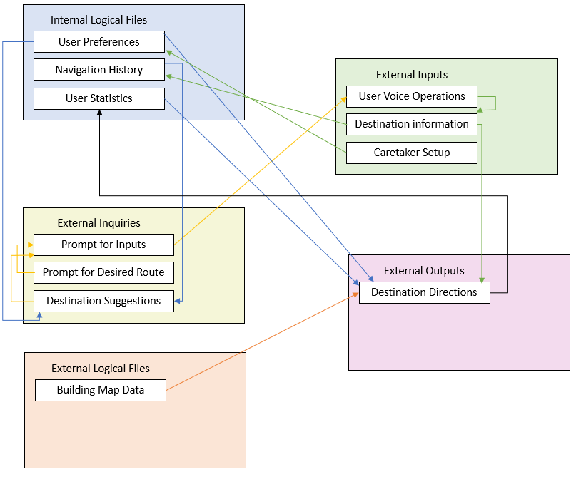
Block Diagram Overview
Notes:
Dylan

